Slide 1
Welcome
To
Mrs. Cole Class

Slide 3
Electronic Classroom

Slide 4
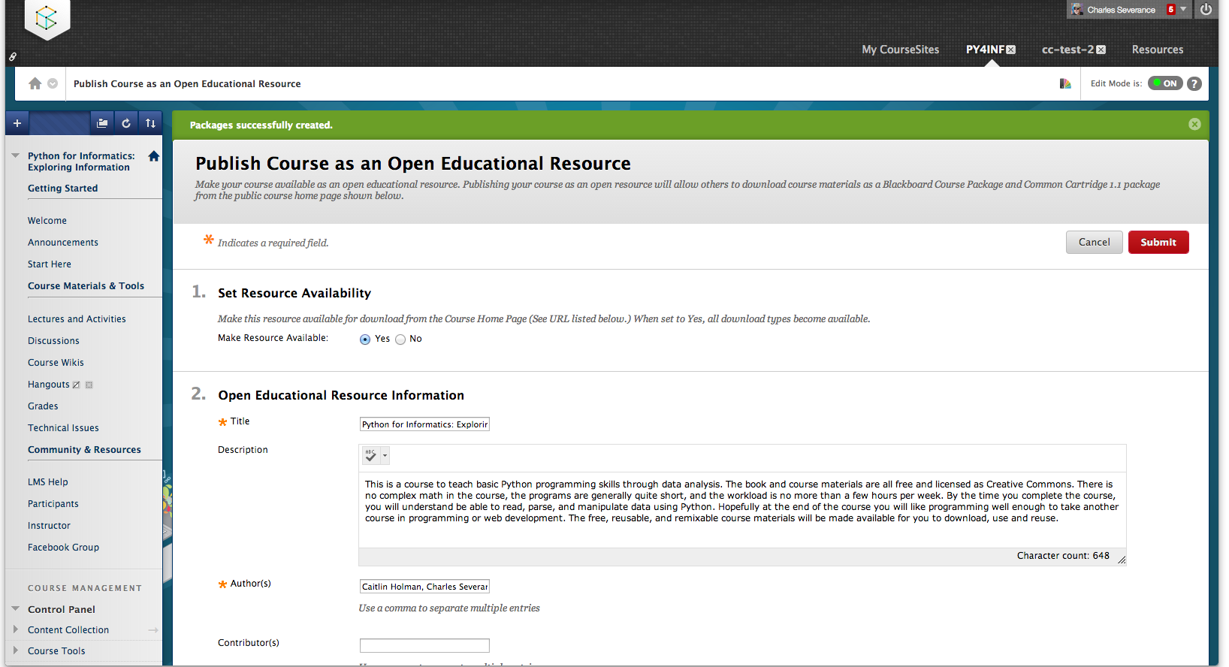
Www.coursesites.coM

Slide 5
9th Grade
-Word
-Excel
** They already passed Powerpoint
10th Grade
-Word
-Powerpoint
-Excel

Slide 6
GMETRIX practice portal……….. They can access it from home.
www.gmetrix.net/download

Slide 8
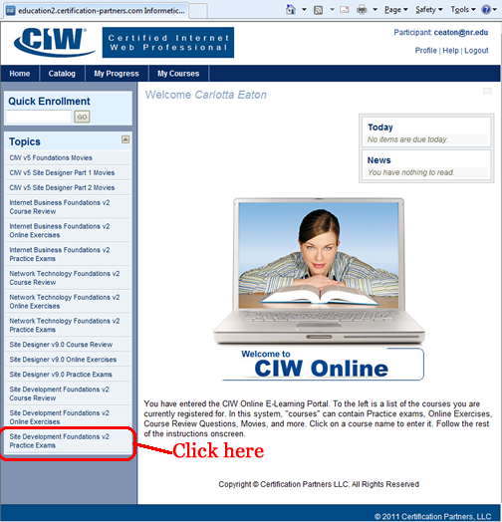
8th Grade
CIW Internet Business Associate

